Slide 1
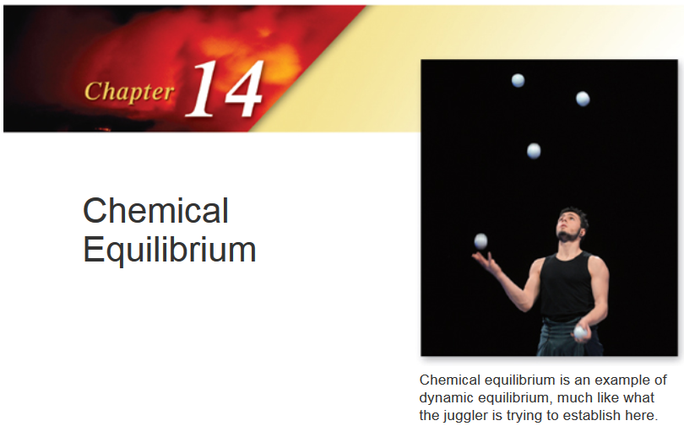

Slide 2
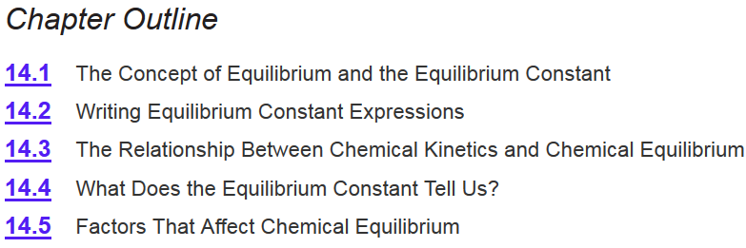
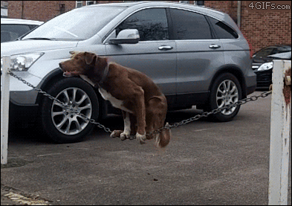

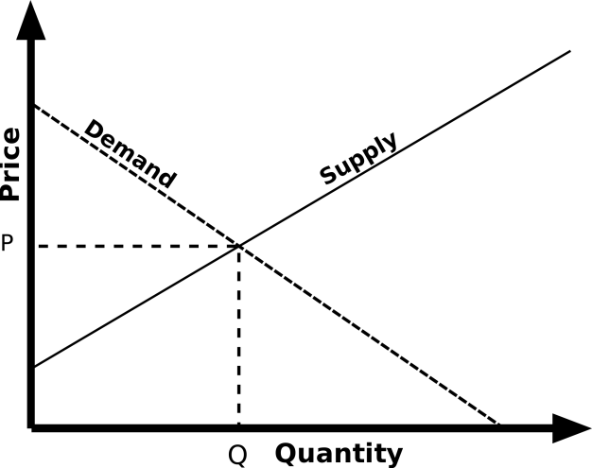
Chapter 14
Ch 14
Page 623

Slide 3
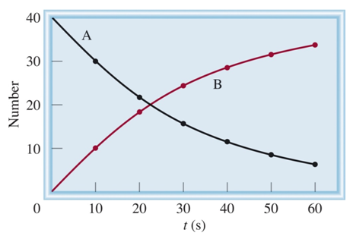
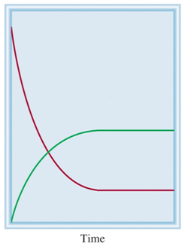
Dynamic Processes
Irreversible process:
A B
A is converted to B until there is no A and only B.
Reversible process:
A B
A
B A
A B
Number
A is in equilibrium with B
B
Neither A nor B are completely consumed during the reaction.

Slide 4
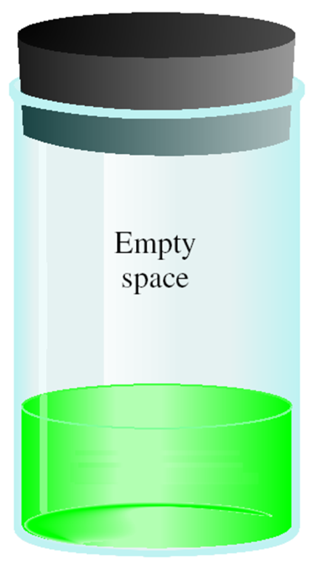

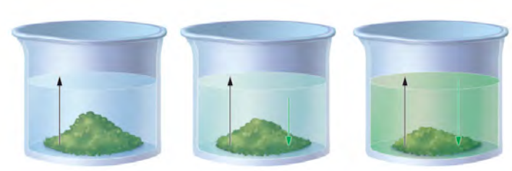
Equilibrium
The change is reversible
The system is “closed”—no substance can enter or leave
The system is dynamic - At the macroscopic level, it appears as if nothing is happening, but at the particulate level, reversible changes are occurring continuously.
Can be at physical equilibrium or chemical equilibrium
A B
Physical Equilibrium- forward and reverse processes occur at the same rate but there is no chemical change.
Solubility
Vapor Pressure
Liquid
At time = 0
At time > 0
At time = ∞
At time = 0
At time > 0
At time = ∞
rate of dissolution
rate of precipitation
rate of vaporization
rate of condensation
=
=

Slide 5
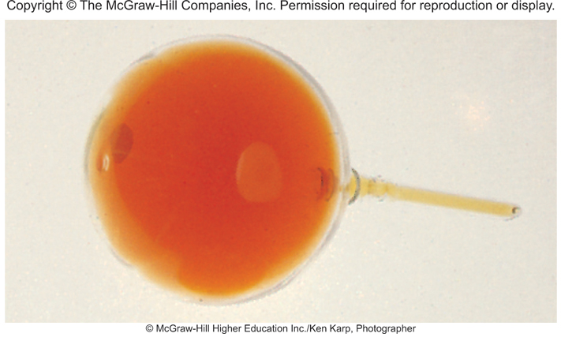
Equilibrium
The change is reversible
The system is “closed”—no substance can enter or leave
The system is dynamic - At the macroscopic level, it appears as if nothing is happening, but at the particulate level, reversible changes are occurring continuously
Can be at physical equilibrium or chemical equilibrium
A B
Chemical Equilibrium-
the rates of the forward and reverse reactions are equal .
a chemical change is occurring (intramolecular bonds broken/formed)
concentrations of the reactants and products remain constant.
this does not mean [conc] of reactants and products are equal!
NO₂
N₂O₄ _{(g)}
2NO₂ _{(g)}

Slide 6
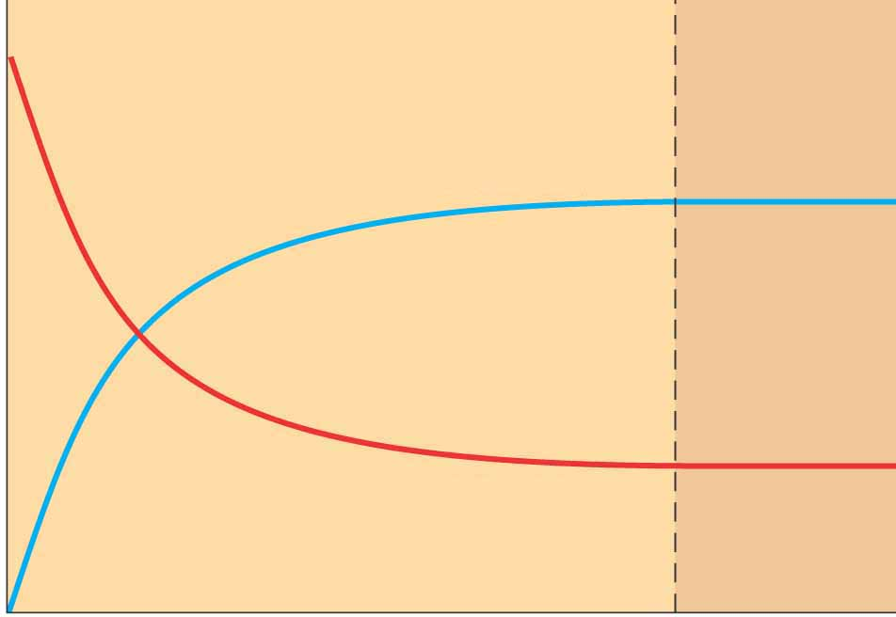
Equilibrium and Rate
At time ~0:
[B] = 0, [A] > 0
B formation = k_{A}[A]
At time 1
[B] > 0, [A] > 0
rate_{A→B} >> Rate_{B→A}
At time 2
[B] = [A]
k_{A}/rate_{A→B} = k_{B} / rate_{B→A}
At time 4
[B] > 0, [A] > 0
rate_{A→B} > Rate_{B→A}
At time n ◊ ∞
[B] unchanged, [A] unchanged
rate_{A→B} = Rate_{B→A}
A B
rate_{A→B} = k_{A} [A]
B A
rate_{B→A} = k_{B} [B]
B
Number
A
0
1
2
4
n
time
At equilibrium!

Slide 7
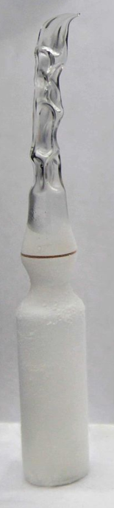
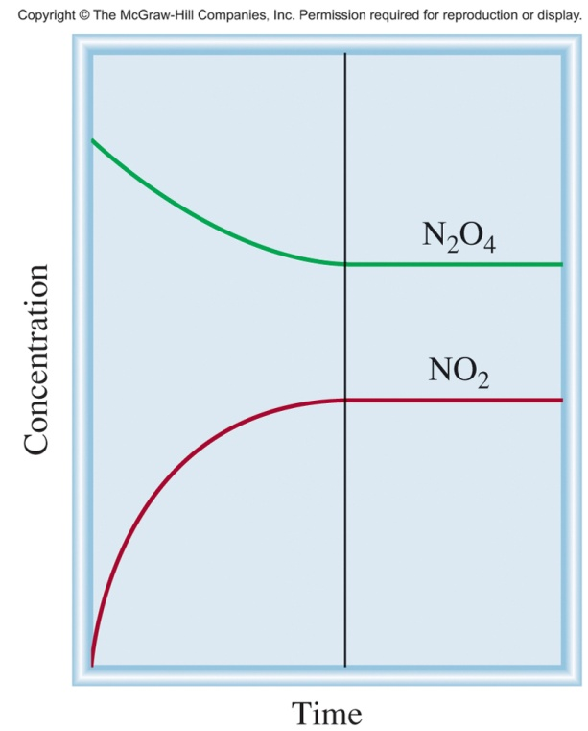
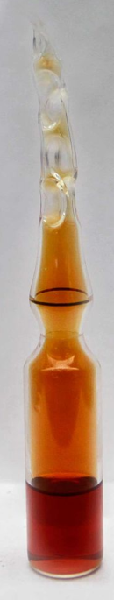
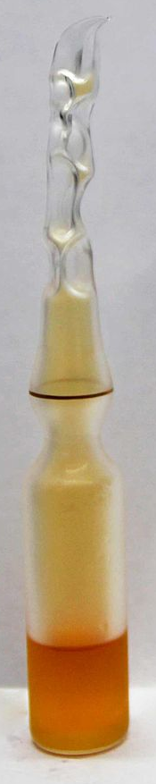
Equilibrium and Rate
N₂O₄ _{(g)}
2NO₂ _{(g)}
Rate_{fwd} = k_{fwd}[NO₂]²
Rate_{rev} = k_{rev}[N₂O₄]
  At equilibrium:
  Each compound is produced and consumed at the same rate.
  Rate_{fwd} = Rate_{rev}

Slide 8
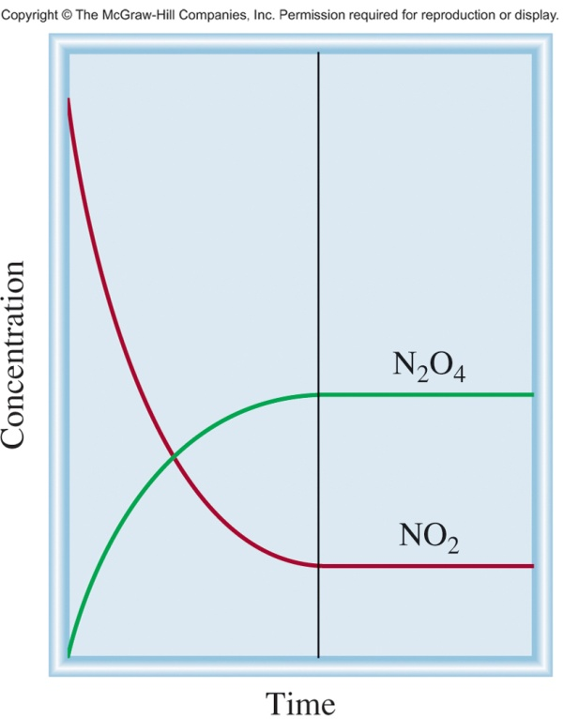
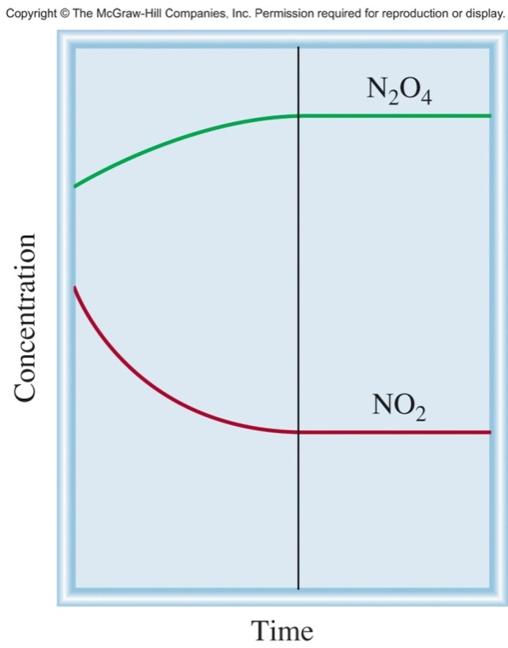
Equilibrium and Rate
N₂O₄ _{(g)}
2NO₂ _{(g)}
equilibrium
equilibrium
equilibrium
Start with NO₂
Start with N₂O₄
Start with NO₂ & N₂O₄
No matter what concentrations you start with, at some point:
Rate_{fwd} = Rate_{rev}
The reaction will reach equilibrium!

Slide 9
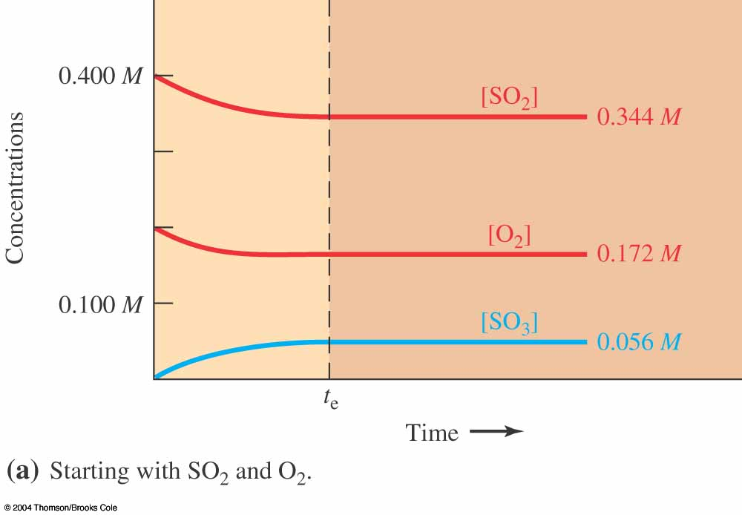
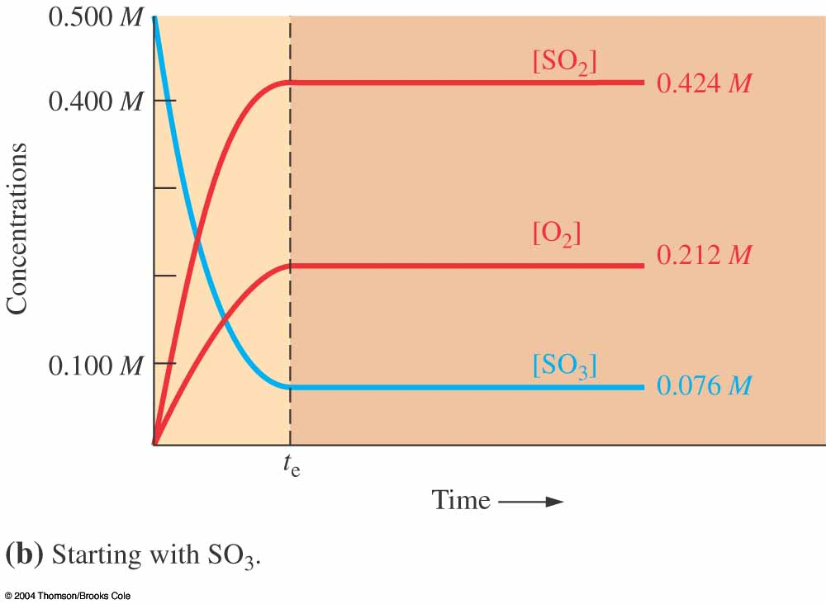
Three Species Equilibrium
No matter what concentrations you start with, at some point:
Rate_{fwd} = Rate_{rev}
The reaction will reach equilibrium!

Slide 10
Chapter 14
Ch 14
Page 623

Slide 11
Equilibrium Concentrations
A B
Equilibrium does not mean that concentrations are all equal!!
However, concentrations at equilibrium are related to the fwd/rev rate constants.
Every equilibrium has its own equilibrium constant.
rate_{A→B} = k_{A} [A]
rate_{B→A} = k_{B} [B]
At equilibrium:
rate_{A→B} = rate_{B→A}
k_{A} [A] = k_{B} [B]
Rate constant A→B
k_{A}
[B]
Rate constant B→A
=
=
K
k_{B}
[A]

Slide 12
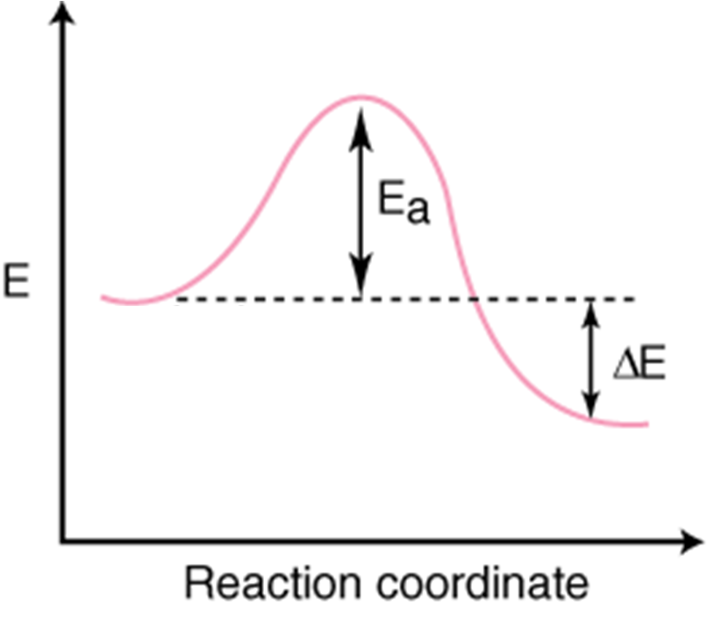
Reaction Diagram
A B
Reverse Reaction
Forward Reaction
A
B
At equilibrium, the number of balls rolling over the hill in each direction is equal.

Slide 13
Equilibrium Constant
For a general reversible reaction such as:
the equilibrium constant is written as
The equilibrium constant for the overall reaction includes stoichiometric coefficients.
aA + bB cC + dD
Law of Mass Action
General practice is not to include units for the equilibrium constant.

Slide 14
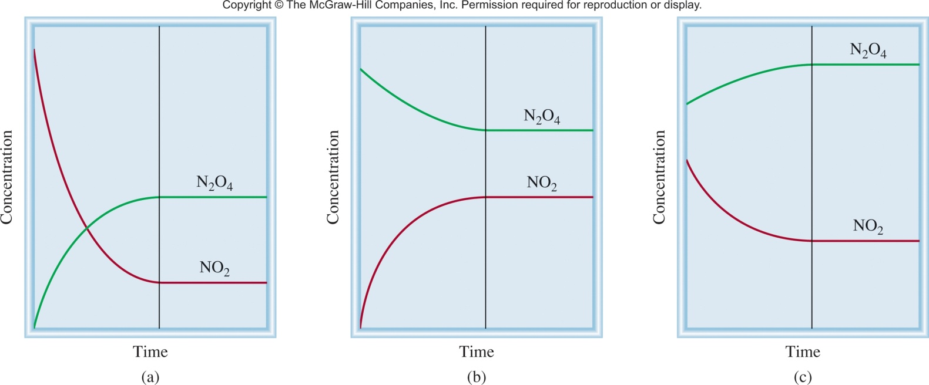
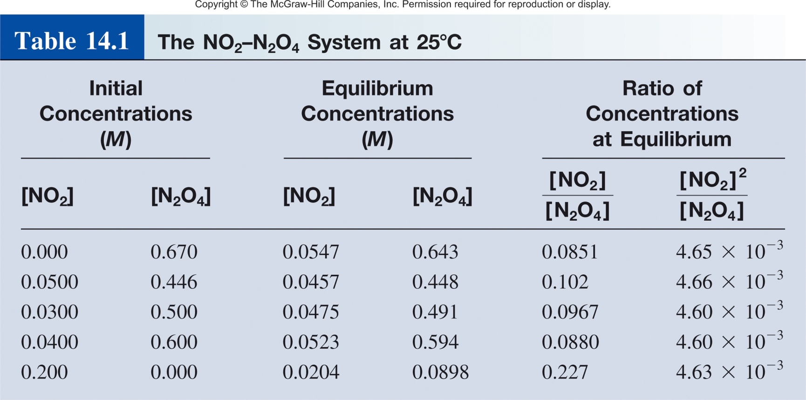
Equilibrium Constant
N₂O₄ _{(g)}
2NO₂ _{(g)}
[NO₂]²
K
=
[N₂O₄]
K
= 4.6 x 10⁻³

Slide 15

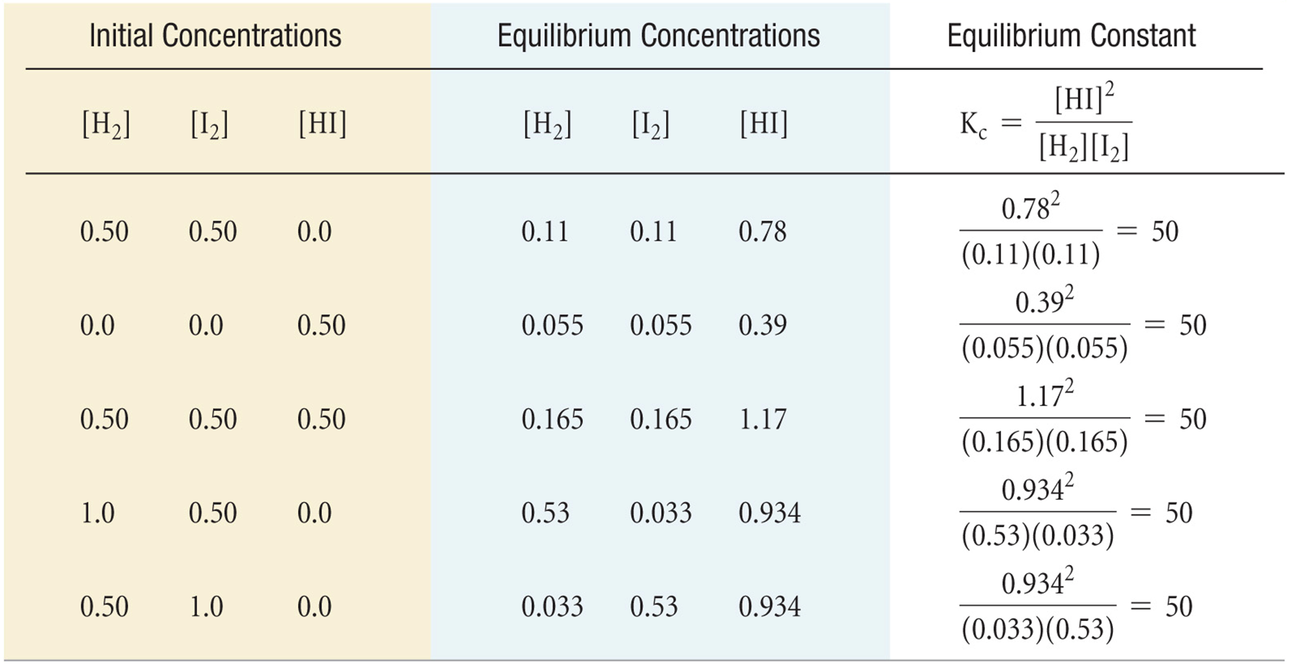
Three Species Equilibrium
No matter how you set up the reaction, the value of the equilibrium constant will be the same if the temperature is the same.

Slide 16
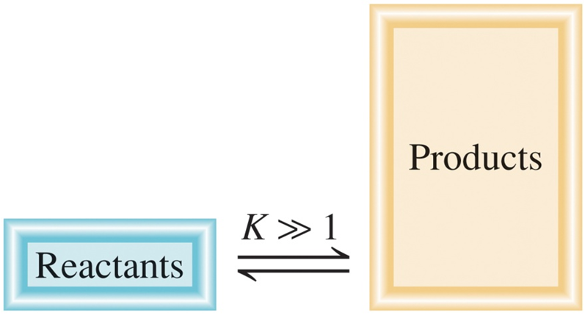
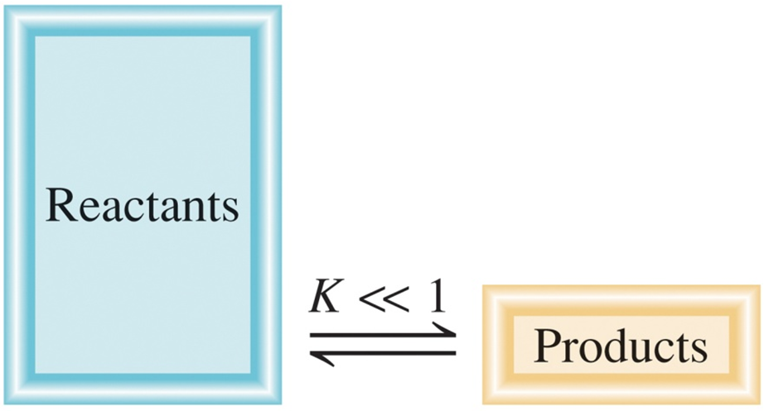
Equilibrium Constant
[C]^{c}[D]^{d}
aA + bB cC + dD
K =
[A]ª[B]^{b}
K >> 1
Favor product formation
k_{fwd} > k_{rev}
aA + bB cC + dD
K << 1
Favor reactant formation
k_{fwd} < k_{rev}
aA + bB cC + dD

Slide 17
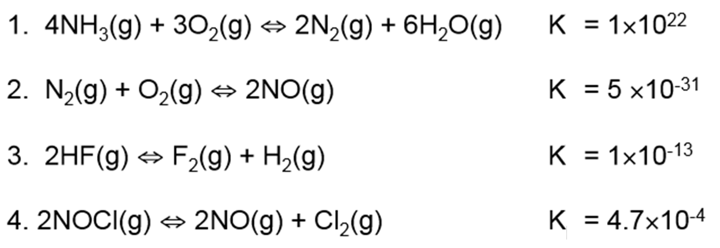
Equilibrium Constant
Which reaction most favors the formation of products?
Which reaction most favors the formation of reactants?

Slide 18
Chapter 14
Ch 14
Page 623

Slide 19
Equilibrium Constant
For a general reversible reaction such as:
aA + bB cC + dD
Equilibrium constants can be expressed using K_{c} or K_{p}.
K_{c} uses the concentration of reactants and products.
K_{p} uses the pressure of the gaseous reactants and products.
[C]^{c}
[D]^{d}
K_{c} =
[A]ª
[B]^{b}
P_{C}^{c}
P_{D}^{d}
K_{p} =
P_{A}ª
P_{B}^{b}

Slide 20
14.2
The following equilibrium process has been studied at 230°C:
2NO(g) + O₂(g) 2NO₂(g)
In one experiment, the concentrations of the reacting species at equilibrium are found to be [NO] = 0.0542 M, [O₂] = 0.127 M, and [NO₂] = 15.5 M. Calculate the equilibrium constant (K_{c}) of the reaction at this temperature.
Solution The equilibrium constant is given by
Substituting the concentrations, we find that
If you are given pressures, you would use K_{p}

Slide 21
14.3
The equilibrium constant K_{P} for the decomposition of phosphorus pentachloride to phosphorus trichloride and molecular chlorine
PCl₅(g) PCl₃(g) + Cl₂(g)
is found to be 1.05 at 250°C. If the equilibrium partial pressures of PCl₅ and PCl₃ are 0.875 atm and 0.463 atm, respectively, what is the equilibrium partial pressure of Cl₂ at 250°C?
Given K_{p}, P_{PCl5}, and P_{Cl3}
Find P_{Cl2}

Slide 22
Equilibrium
N₂O₄ _{(g)}
2NO₂ _{(g)}
In terms of concentration (K_{c})
In terms of pressure (K_{P})
[NO₂]²
P ²
K_{c} =
K_{p} =
NO₂
[N₂O₄]
P
N₂O₄
K_{c} ≠ K_{p}
…at least not always!

Slide 23




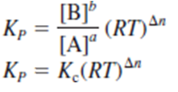
K_{c} vs K_{p}
aA_{(g)}
bB_{(g)}
Substitution

Slide 24
K_{c} vs K_{p}
aA + bB cC + dD
[C]^{c}
[D]^{d}
P_{C}^{c}
P_{D}^{d}
K_{c} =
K_{p} =
[A]ª
[B]^{b}
P_{A}ª
P_{B}^{b}
K_{p} = K_{c}(RT)^{Δn}
Δn = moles of gaseous products – moles of gaseous reactants
Δn = (c + d) – (a + b)
When does K_{p} equal K_{c}?

Slide 25
14.4
Methanol (CH₃OH) is manufactured industrially by the reaction
CO_{(g)} + 2H_{2(g)} CH₃OH_{(g)}
The equilibrium constant (K_{c}) for the reaction is 10.5 at 220°C. What is the value of K_{P} at this temperature?
K_{p} = K_{c}(RT)^{Δn}
R = 0.0821 L atm/K mol
T = 273 + 220 = 493 K
Δn = = 1 - 3 = -2
K_{P} = (10.5) (0.0821 x 493)⁻²
K_{P} = 6.41 x 10⁻³

Slide 26
Equilibrium Constants Example
The equilibrium concentrations for the reaction between carbon monoxide and molecular chlorine to form COCl₂ (g) at 74°C are [CO] = 0.012 M, [Cl₂] = 0.054 M, and [COCl₂] = 0.14 M. Calculate the equilibrium constants K_{c} and K_{p}.
CO _{(g)} + Cl₂ _{(g)} COCl₂ _{(g)}
[COCl₂]
0.14
K_{c} =
=
= 220
[CO][Cl₂]
0.012 x 0.054
K_{p} = K_{c}(RT)^{Δn}
R = 0.0821 L atm/K mol
T = 273 + 74 = 347 K
Δn = 1 – 2 = -1
K_{p} = 220 x (0.0821 x 347)⁻¹ = 7.7

Slide 27
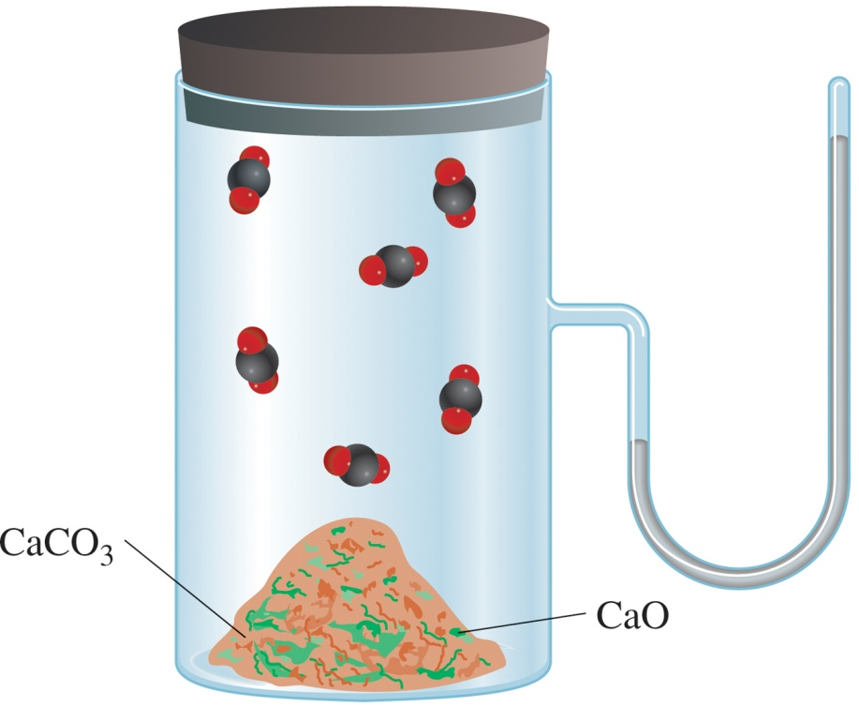
Equilibria: Phases Matter
Homogenous equilibrium- all reacting species are in the same phase.
Heterogeneous equilibrium- reacting species are in different phases.
gas – gas
liquid-liquid
liquid-aqueous
gas – liquid
liquid-solid
solid-gas
N₂O₄ _{(g)}
2NO₂ _{(g)}
CaCO₃ _{(s)} CaO _{(s)} + CO₂

Slide 28



Homogenous Equilibria
-all reacting species are in the same phase.
gas-gas equilibria
N₂(g) + 3H₂(g) ⇄ 2NH₃(g)
[NH₂]²
P_{NH3}²
K_{c} =
K_{p} =
[N₂][H₂]³
P_{N2}
P_{H2}³
CH₄(g) + 3H₂O(g) ⇄ CO_{(g)} + 3H₂(g)
H₂O is often used as a solvent(l). However, if H₂O is written as a gas (g), then its concentration must be considered in K_{c} and K_{p}.
[CO]
[H₂]²
P_{CO}
P_{H}²
K_{c} =
K_{p} =
[CH₄][H₂O]³
P_{CH4}
P_{H2O}³

Slide 29
Homogenous Equilibria
-all reacting species are in the same phase.
liquid equilibrium
CH₃COOH _{(aq)} + H₂O _{(l)} CH₃COO⁻ _{(aq)} + H₃O⁺ _{(aq)}
[CH₃COO⁻][H₃O⁺]
[H₂O] = solvent
[H₂O] = constant
K_{c}‘ =
[CH₃COOH][H₂O]
The concentration of pure liquids are not included in the expression for the equilibrium constant.
[CH₃COO⁻][H₃O⁺]
K_{c} =
[CH₃COOH]

Slide 30
14.1
Write expressions for K_{c}, and K_{P} if applicable, for the following reversible reactions at equilibrium:
HF_{(aq)} + H₂O_{(l)} H₃O⁺_{(aq)} + F⁻_{(aq)}
(b) 2NO_{(g)} + O_{2(g)} 2NO_{2(g)}
(c) CH₃COOH_{(aq)} + C₂H₅OH_{(aq)} CH₃COOC₂H_{5(aq)} + H₂O_{(l)}

Slide 31
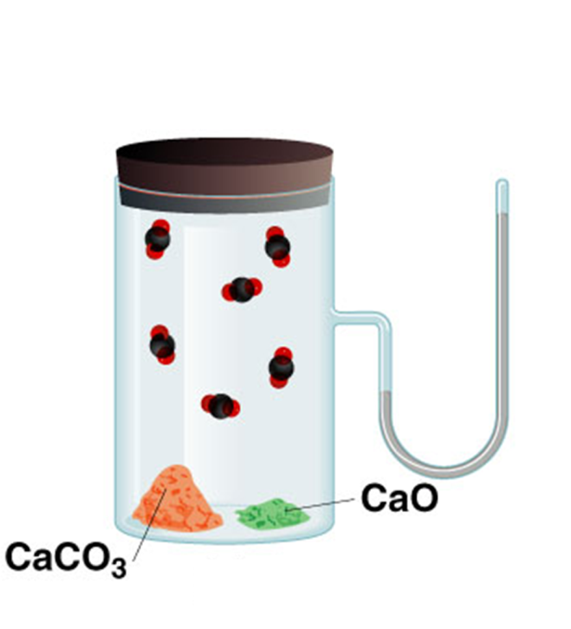
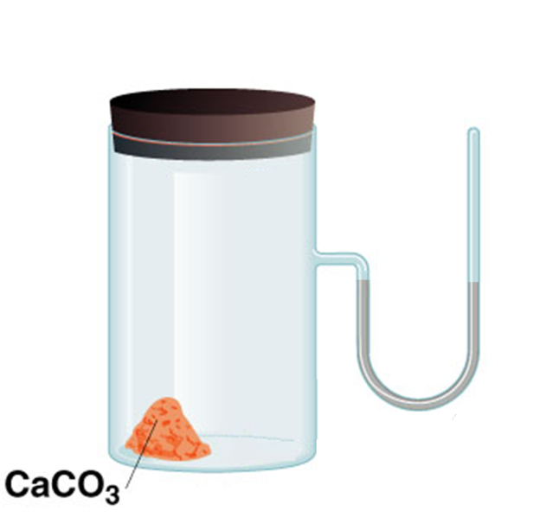
Heterogenous Equilibria
-reacting species are in different phases.
Can include liquids, gases and solids as either reactants or products.
Equilibrium expression is the same as that for a homogeneous equilibrium.
Note CaO will not form a neat separated pile!
CaCO₃ _{(s)} CaO _{(s)} + CO₂ _{(g)}
time

Slide 32
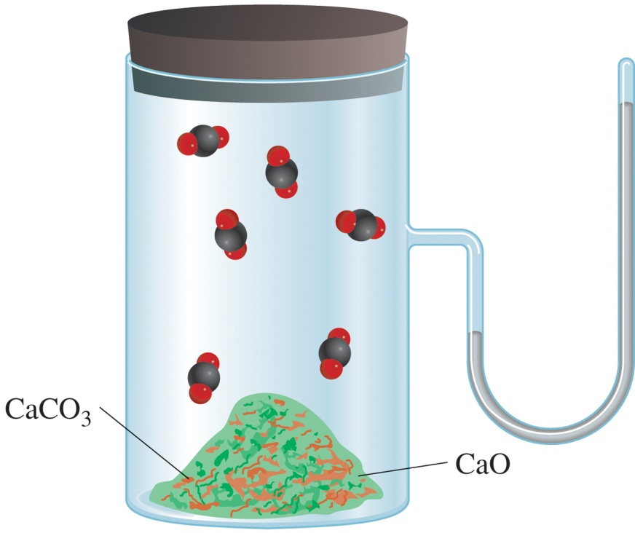
Heterogenous Equilibria
CaCO₃ _{(s)} CaO _{(s)} + CO₂ _{(g)}
[CaO][CO₂]
K_{c}’ =
[CaCO₃]
P_{CO2} or [CO₂] does not depend on the amount of CaCO₃ or CaO

Slide 33
Heterogenous Equilibria
CaCO₃ _{(s)} CaO _{(s)} + CO₂ _{(g)}
[CaO][CO₂]
K_{c}’ =
[CaCO₃]
Activity- is a measure of the “effective concentration” of a species in a mixture.
Activity of a solid = 1
[1][CO₂]
K_{c}’ =
[1]
K_{c}’ =
[CO₂]
K_{p} = P_{CO}
2
The concentration of solids are not included in the expression for the equilibrium constant.

Slide 34
14.6
Consider the following heterogeneous equilibrium:
CaCO_{3(s)} CaO_{(s)} + CO_{2(g)}
At 800°C, the pressure of CO₂ is 0.236 atm. Calculate:
K_{P}
(b) K_{c}
K_{p} = P_{CO}
2
K_{P} = 0.236
K_{p} = K_{c}(RT)^{Δn}
R = 0.0821 L atm/K mol
T = 273 + 800 = 1073 K
Δn = 1 – 0 = 1
0.236 = K_{c}(0.0821 x 1073)¹
K_{c} = 2.68 x 10⁻³

Slide 35
14.5
Write the equilibrium constant expression K_{c}, and K_{P} if applicable, for each of the following heterogeneous systems:
(NH₄)₂Se_{(s)} 2NH_{3(g)} + H₂Se_{(g)}
(b) AgCl_{(s)} Ag⁺_{(aq)} + Cl⁻_{(aq)}
(c) P_{4(s)} + 6Cl_{2(g)} 4PCl_{3(l)}
K_{c} = [NH₃]²[H₂Se]
K_{c} = [Ag⁺][Cl⁻]

Slide 36
Chapter 14
Ch 14
Page 623

Slide 37
Equilibrium Concentrations
A B
Equilibrium does not mean that concentrations are all equal!!
However, concentrations at equilibrium are related to the fwd/rev rate constants.
Every equilibrium has its own equilibrium constant.
rate_{A→B} = k_{A} [A]
rate_{B→A} = k_{B} [B]
At equilibrium:
rate_{A→B} = rate_{B→A}
k_{A} [A] = k_{B} [B]
Rate constant A→B
k_{A}
[B]
Rate constant B→A
=
=
K
k_{B}
[A]

Slide 38
Equilibrium Constant
For a general reversible reaction such as:
the equilibrium constant is written as
aA + bB cC + dD
Law of Mass Action
The concentration of pure liquids or solids are not included in the expression for the equilibrium constant.

Slide 39
Equilibrium Constant
For a general reversible reaction such as:
aA + bB cC + dD
Equilibrium constants can be expressed using K_{c} or K_{p}.
K_{c} uses the concentration of reactants and products.
K_{p} uses the pressure of the gaseous reactants and products.
[C]^{c}
[D]^{d}
K_{c} =
[A]ª
[B]^{b}
P_{C}^{c}
P_{D}^{d}
K_{p} =
P_{A}ª
P_{B}^{b}

Slide 40
K_{c} vs K_{p}
aA + bB cC + dD
[C]^{c}
[D]^{d}
P_{C}^{c}
P_{D}^{d}
K_{c} =
K_{p} =
[A]ª
[B]^{b}
P_{A}ª
P_{B}^{b}
K_{p} = K_{c}(RT)^{Δn}
Δn = moles of gaseous products – moles of gaseous reactants
Δn = (c + d) – (a + b)

Slide 41
Writing Equilibrium Constant Expressions
The concentrations of the reacting species in the condensed phase are expressed in M. In the gaseous phase, the concentrations can be expressed in M or in atm.
The concentrations of pure solids, pure liquids and solvents do not appear in the equilibrium constant expressions.
The equilibrium constant is a dimensionless quantity.
In quoting a value for the equilibrium constant, you must specify the balanced equation and the temperature.

Slide 42
Multiple Equilibria
  A reaction can be an individual reaction step or a multistep reaction
  If the overall reaction is the sum of two or more reactions, the overall reaction Equilibrium Constant is the product of the Equilibrium Constants for the steps

Slide 43
Multiple Equilibria
Product molecules of one equilibrium constant are involved in a second equilibrium process.
‘
[C][D]
A + B C + D
K_{c}
‘
K_{c} =
[A][B]
C + D E + F
‘
‘
K_{c}
[E][F]
‘
‘
A + B E + F
K_{c}
K_{c} =
[C][D]
[C][D]
[E][F]
[E][F]
‘
‘
K_{c}
‘
x
K_{c} =
K_{c} =
x
K_{c}
=
[A][B]
[C][D]
[A][B]
If a reaction can be expressed as the sum of two or more reactions, the equilibrium constant for the overall reaction is given by the product of the equilibrium constants of the individual reactions.

Slide 44
Practice Problem
Determine the overall equilibrium constant for the reaction between Nitrogen & Oxygen to form the toxic gas Nitrogen Dioxide – a component of atmospheric smog
N₂(g) + O₂(g) ⇆ 2NO(g)
K_{c1}
2NO(g) + O₂(g) ⇆ 2NO₂(g)
K_{c2}
Overall: N₂(g) + 2O₂(g) ⇆ 2NO₂(g)

Slide 45
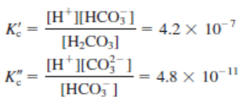


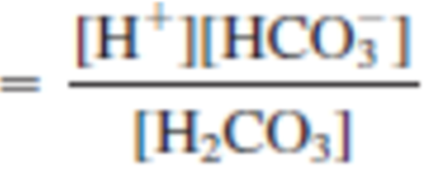
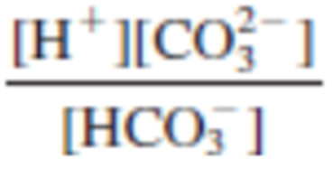


Multiple Equilibria
Overall Equilibrium:
Equilibrium 1:
Equilibrium 2:
x

Slide 46
Rules for Manipulating K
  The overall reaction equilibrium constant (K) is the product of the equilibrium constants for the steps.
If the equation is reversed, the equilibrium constant is inverted.
If the equation is multiplied by a factor, the equilibrium constant is raised to the same factor.

Slide 47
14.7
Write the equilibrium constant expression for each formulation :
N_{2(g)} + 3H_{2(g)} 2NH_{3(g)}
(b) N_{2(g)} + H_{2(g)} NH_{3(g)}
(c) N_{2(g)} + H_{2(g)} NH_{3(g)}
(d) How are the equilibrium constants related to one another?

Slide 48
Writing Equilibrium Constant Expressions
The concentrations of the reacting species in the condensed phase are expressed in M. In the gaseous phase, the concentrations can be expressed in M or in atm.
The concentrations of pure solids, pure liquids and solvents do not appear in the equilibrium constant expressions.
The equilibrium constant is a dimensionless quantity.
In quoting a value for the equilibrium constant, you must specify the balanced equation and the temperature.
If a reaction can be expressed as a sum of two or more reactions, the equilibrium constant for the overall reaction is given by the product of the equilibrium constants of the individual reactions.

Slide 49
Chapter 14
Ch 14
Page 623

